Slide 1
Function as a Service
First Demo

Slide 2
Content
Background and Story -- Lian
System -- Yuxuan
Current Progress and Future Work -- Zhuyu
Demo -- Yuhang

Slide 3
Function as a Service
Users upload source to the cloud, and the cloud provider is tasked with executing users' functions on demand
No fixed amount resource -- pay for what is asked for
Characteristic: in the FaaS model, users can theoretically change their allocation from zero cores to thousands and back to zero again within hundreds of milliseconds, paying for exactly what they use
Our purpose: build an application on top of the OpenWhisk FaaS system

Slide 4
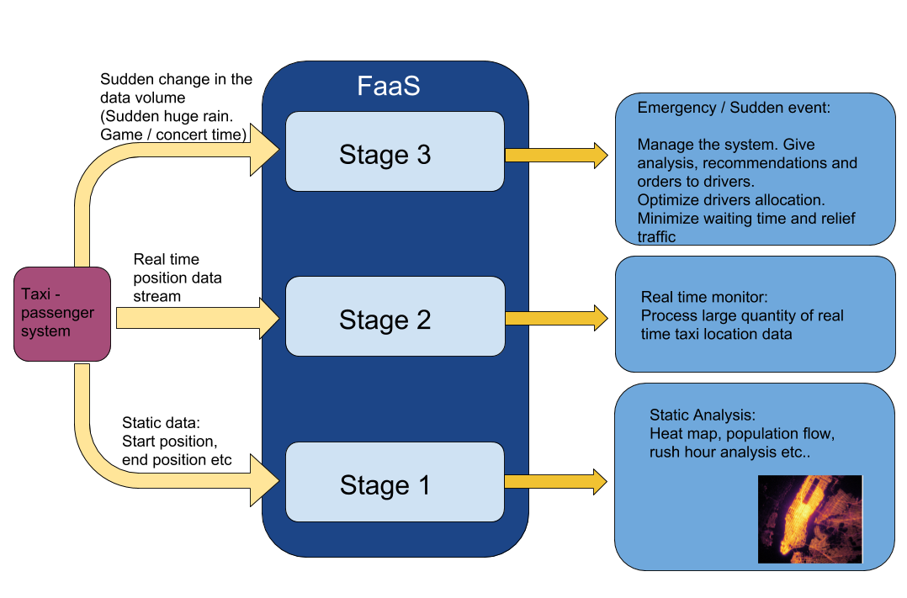
Taxi Driver - Passenger system
Taxi - passenger
Start -- pick up pairing population flow, time/space analysis
Use Faas -- Sudden events

Slide 5



System Diagram
application
OpenWhisk
Consul
Function A
event
event
Nginx
Controller
Kafka
Function B
event
...
...
Conditional Routing
CouchDB
Function C
user-client

Slide 6
Technologies
User Client:
Develop an Android Application
OpenWhisk:
Deploy OpenWhisk on GKE cluster with 2~3 nodes on Google Cloud
Database:
Use Redis to store real-time taxi data

Slide 7
Current Progress: Sprint 1
Set Up and Implementation
Deploy OpenWhisk on Kubernetes (Local Deployment)
Mac
Linux (Ubuntu)
Basic test for OpenWhisk
Simple demo records number of user visits
Agile working management: Taiga
Epic: Concept Abstraction
US Points: Redefine
Burn down chart

Slide 8
Demo

Slide 9
Future Work: Sprint 2
Complete Queries Define
Api for passenger/driver
Design Data Model
Data Scalability
Cache Eviction
Implement Data Storage Part
Store data from resources to DB
Implement Basic Front End Part
A web app to present data stored in DB

Slide 10
Questions?

